Slide 1
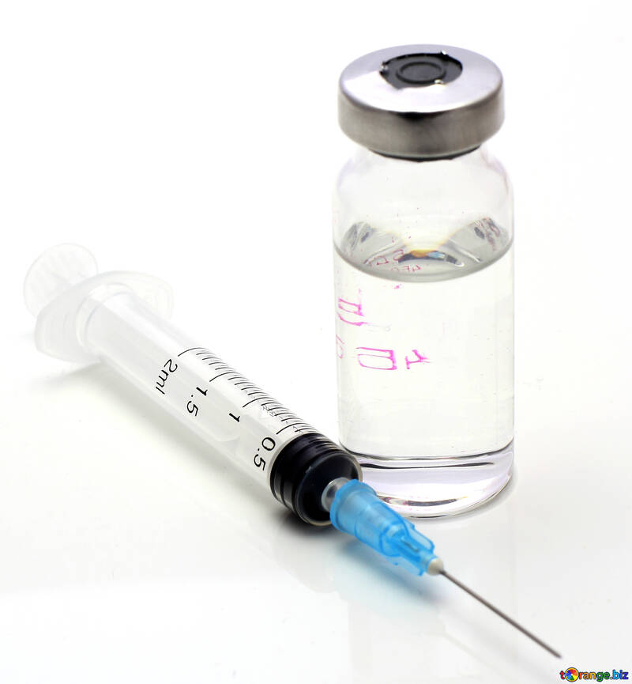
COVID-19 Vaccine Implementation in Nursing Homes: Increasing Vaccine Confidence A Guide for Facility Leadership
Michael Wasserman, MD, CMD CALTCM
Special thanks to Dr. Leslie Eber, AMDA,
and the CALTCM Vaccine Delphi Group
This Photo by Unknown Author is licensed under CC BY

Slide 2
CALTCM’s Long Term Care Quadruple Aim for COVID-19 Response
Abundant PPE
Readily Available Testing
Stellar Infection Control
Emergency Preparedness Mode
5th Element: Vaccine!

Slide 3
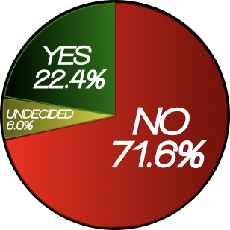
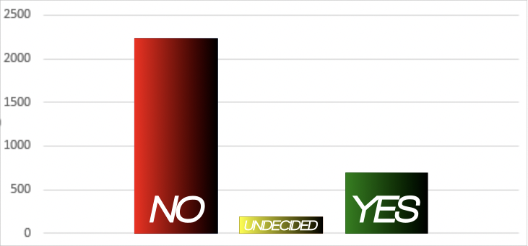
NAHCA INFORMAL POLL
CNAs Respond to, “Will You Take the COVID Vaccine? Yes or No.”
Response | Number Percentage
No | 2,233 | 71.6%
Undecided | 188 | 6.0%
Yes | 698 | 22.4%
TOTAL | 3,119 | 100%
*This informal polling took place across various platforms NAHCA is engaged in.
*Not a controlled survey. *NAHCA will be performing a more controlled survey and analysis.

Slide 4
NAHCA Informal Poll: Vaccine Hesitancy in CNAs
Themes
Lack of trust.
Lack of education and information on the vaccine.
Sub-Themes
Hesitancy due to rapidness of vaccine launch.
Lack of information on potential risks and side effects.
Some will not take the vaccine unless it’s mandatory. Others will quit the profession entirely if made mandatory.
No knowledge of the ingredients in the vaccine.
For those who said they would take it, the reasoning was due to experience in already contracting the virus or to protect their residents.

Slide 5
The Need to Increase COVID-19 Vaccine Confidence is Real*
Specific LTC staff concerns:
“Being first”
Safety
Not being represented in the vaccine trials
Most important factors for acceptance
Efficacy
Duration of protection
Lower incidence of major side effects
Other factors:
EUA (Emergency Use Authorization)
Vaccine developed outside the United States.
*JAMA Network Open. 2020;3(10):e2025594. doi:10.1001/jamanetworkopen.2020.25594

Slide 6
Best Practice: Town Halls “Respect, Honor & Value”
If possible, focus first “town hall” session on allowing staff to share their concerns
It is critical that staff knows that you are HEARING their concerns
Demonstrate that their concerns are being heard
Do not try to correct concerns
Have multiple town halls, to allow time to digest information

Slide 7
IDT STORY
Visiting facility while CMO
Asked CNA if she was comfortable telling nurse impression about patient
Administrator answered
CNA’s reaction
Respect, Honor and Value

Slide 8
How to Frame the Conversation
Don’t force the issue
Meet people where they are
Everyone has questions and concerns and that is understandable
Answer questions with respect and honesty
Most Important: This is what we have been waiting for!
This is how we save lives, our own, and everyone around us
For the first time in the United States, long term care staff are first, we have risked our lives caring for our residents and now we can protect everyone even more

Slide 9
A Strategy for COVID-19 Education
Is it safe?
Why should we trust the vaccine?
Is there new technology being used and is that dangerous to me?
What is an EUA and what does that mean for me?
When and how long will I be protected?
Will I still need to wear a mask?
Expectations: Important to warn people about possible side effects
Special circumstances: What if I had COVID-19 or if I have antibodies?
REVIEW: WHERE ARE YOU GETTING YOUR INFORMATION?

Slide 10
Are the COVID-19 vaccines safe?
Safety is the most important priority in vaccine approval.
Most adverse side effects occur within 6 weeks of vaccine administration, and the FDA has required 8 weeks of safety monitoring.
FDA advises a minimum of 3,000 participants to assess safety. The current phase 3 trials have 30,000 to 50,000 participants. This really demonstrates how safety is a top priority for the FDA and the medical community.

Slide 11
Why should we trust the COVID-19 vaccine?
The FDA is using the same standards that it has for decades
There are no steps being “skipped”
Two (2) advisory committees:
The Vaccine and Related Biological Products Advisory Committee (VRBPAC) that advises the FDA
The Advisory Committee on Immunization Practices (ACIP) that advises the CDC.

Slide 12
New Technology for the COVID-19 Vaccine
mRNA Vaccines
Viral Vectors
Can these new technologies give me COVID-19? NO
Can these new technologies change my DNA? NO

Slide 13
What is an EUA and what does that mean for me?
An Emergency Use Authorization (EUA) for a vaccine is based on the need to use a vaccine quickly to save lives during a public health emergency.
EUA is a shorter process but no steps are skipped in the safety evaluation process.
FDA approval can still take weeks.
The FDA will assess if the vaccine's known and potential benefits outweigh the known and potential risks.
Both advisory boards (VRBPAC and ACIP) will also review all the data and make recommendations.
An EUA does not imply that the authorization was done too quickly or that the vaccine is not safe.

Slide 14
When and how long will I be protected by the COVID-19 vaccine?
Be Transparent and Honest
We will most likely not know how long the vaccine will be protective when we receive it
More research needed
Most of the vaccines are 2 doses, 3-4 weeks apart
Protection 1-2 weeks after the second dose
May need to have vaccine shots for COVID-19 on a regular basis (like the flu shot)

Slide 15
Will I still need to wear a mask?
YES!
Wear it properly!
Wash your hands!
Stick to the Quadruple Aim!

Slide 16
Important: Warn About Possible Side Effects Will the vaccine make me sick?
Short-term discomfort : Headache, muscle pains, fatigue, chills, fever and pain at injection site
1-2 days
Same symptoms as COVID-19:
Emphasize that the vaccine cannot give you COVID-19
More pronounced with second dose
Normal and common
It means your body is doing its job and making antibodies (IT IS A GOOD THING)
MUST COME BACK FOR SECOND DOSE, must be the same vaccine as the first dose

Slide 17
Special Circumstances: Past COVID-19 Infection or Tested for Antibodies
It is safe to get the COVID-19 vaccine even if you have had COVID-19
If + Antibodies PLEASE get the COVID-19 Vaccine
Monoclonal antibody treatment trial

Slide 18
You Will Be the Leader and Role Model
Tell your own vaccine story:
Talk about how will you make your decision
Lead by doing:
Discuss with staff/family your decision to get the vaccine and talk about your experience after you get immunized
Look for role models amongst staff!

Slide 19
Facility Logistical Challenges
Need to stagger vaccinations
Resident side effects and caregiver needs
Potential for staff call outs
Consent forms
Unrepresented residents

Slide 20
Resources
CALTCM Vaccine Resources
https://www.caltcm.org/covid-19
https://www.caltcm.org/covid-19-vaccine
AMDA COVID-19 Vaccine Toolkit
https://bit.ly/2VPvsV8

Slide 21
California Association of Long Term Care Medicine
@CALTCM
#CALTCM
@Wassdoc
Check the CALTCM Website (CALTCM.org) and
e-newsletter, the CALTCM Wave, for updates.

Slide 22
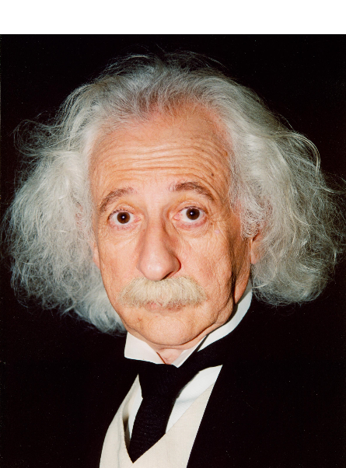
Questions
????

