Slide 1
COVID-19 Vaccine Hesitancy and Education: A Guide for Medical Directors Michael Wasserman, MD, CMD CALTCM
A special thanks to Dr. Leslie Eber, AMDA and the CALTCM Vaccine Delphi Group

Slide 2
COVID-19 vaccine hesitation is real
Kreps et al found in his survey published in JAMA 10/20/20 that the most important factors for acceptance are efficacy, duration of protection and lower incidence of major side effects
Other factors: EUA (Emergency Use Authorization) and a vaccine developed outside the United States.
Specific LTC staff concerns:
“being first”
Safety
Not being represented in the vaccine trials
JAMA Network Open. 2020;3(10):e2025594. doi:10.1001/jamanetworkopen.2020.25594

Slide 3
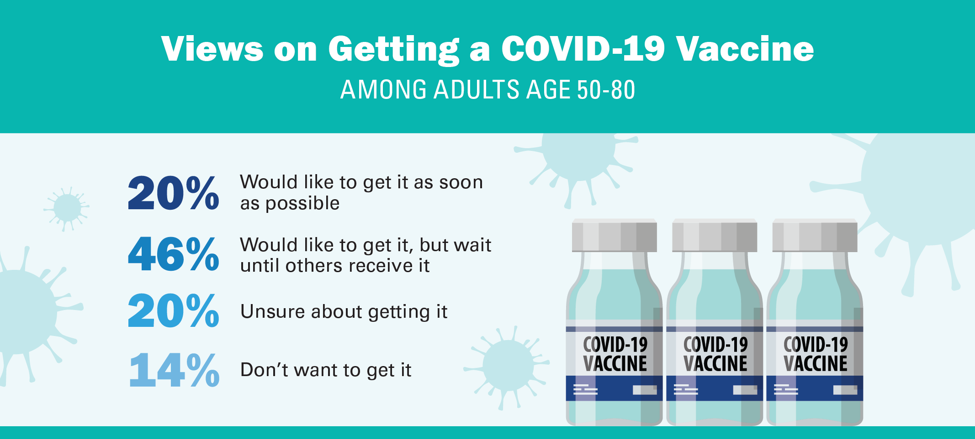
COVID 19 Hesitancy and Older Adults National Poll on Healthy Aging report, University of Michigan (November, 2020)
Malani P, Singer D, Solway E, Kirch M, Kullgren J. Older Adults’ Perspectives on a COVID-19 Vaccine. University of Michigan National Poll on Healthy Aging. November 2020. Available at: http://hdl.handle.net/2027.42/163523

Slide 4
NAHCA Informal Poll: Vaccine Hesitancy in CNAs
Themes
Lack of trust.
Lack of education and information on the vaccine.
Sub-Themes
Hesitancy due to rapidness of vaccine launch.
Lack of information on potential risks and side effects.
Some will not take the vaccine unless it’s mandatory. Others will quit the profession entirely if made mandatory.
No knowledge of the ingredients in the vaccine.
For those who said they would take it, the reasoning was due to experience in already contracting the virus or to protect their residents.

Slide 5
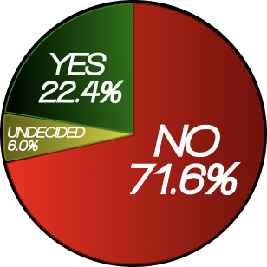
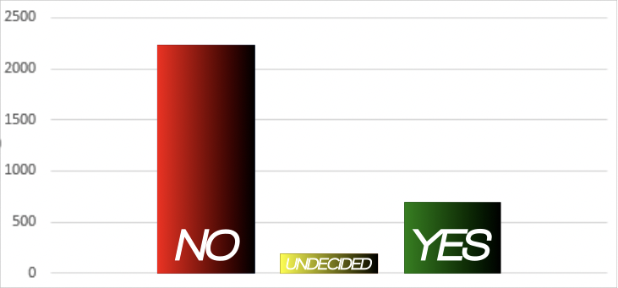
INFORMAL POLL CNAs Respond to, “Will You Take the COVID Vaccine? Yes or No.”
Response | Number Percentage
No | 2,233 | 71.6%
Undecided | 188 | 6.0%
Yes | 698 | 22.4%
TOTAL | 3,119 | 100%
*This informal polling took place across various platforms NAHCA is engaged in.
*Not a controlled survey. *NAHCA will be performing a more controlled survey and analysis.

Slide 6
How to Frame the Conversation
Most Important: This is what we have been waiting for!
This is how we save lives, our own and everyone around us
For the first time in the United States, long term care staff are first, we have risked our lives caring for our residents and now we can protect everyone even more
Meet people where they are
Everyone has questions and concerns and that is understandable
Answer questions with respect and honesty

Slide 7
 |  | Pfizer (BNT162b2) | Moderna (mRNA-1273)
Primary | Trial Size | 41,135 already received 2nd dose (43,661 total enrolled) | 25,654 already received 2nd dose (>30,000 enrolled)
 | Efficacy | 95% (162 cases placebo group vs 8 cases in vaccine group) | 94.5% (90 cases placebo group vs 5 cases vaccine group – interim analysis)
 | Immunity onset | 7 days from 2nd dose | N/A
 | Severe cases | 9 in placebo group vs 1 in vaccine group | 11 in placebo vs 0 in vaccine group
 | Side effects | Fatigue 3.8% Headache 2.0% No severe adverse events Older adults fewer side effects | Injection site pain 2.7% Fatigue 9.7% Myalgia 8.9% Arthralgia 5.2% Headache 4.5% Pain 4.1% Erythema/redness 2.0% No severe adverse events
Sub-groups | Older adults | 45% age 56-85 (40.9% internationally) 94% efficacy for those >65 years in subgroup analysis | >7,000 (23%) age >65 No difference in efficacy or side effects in subgroup analysis
 | Minorities | 30% racially/ethnically diverse backgrounds in US, 42% internationally -10.1% black (10.0% internationally) -13.1% Hispanic (26.1% internationally) No difference in efficacy or side effects in subgroup analysis | >11,000 from communities of color ->6,000 (>20%) self-identify as Hispanic/LatinX ->3,000 (>10%) self-identify as Black No difference in efficacy or side effects in subgroup analysis
 | High Risk Conditions | N/A | 17% age 18-65 with high risk condition (many people 65+ also had another high risk condition) -36% with DM among high risk group -25% with severe obesity among high risk group No difference in efficacy or side effects in subgroup analysis
Storage | Storage | Ultra low cold (-80 deg) 2-8 deg C for 5 days 30 min – 3 hour defrost time 6 hour post-dilution stability at room temperature | Cold storage (-4 deg) 30 day shelf life in freezer 12 hour room temperature stability
Notes: Courtesy of Dr. Anuj Mehta, Data is accurate as of 11/18/2020. More information is constantly becoming available. Sub-group comparisons (e.g. comparisons about efficacy between races or age groups) may be less accurate due to smaller numbers. Sub-group numbers for the Pfizer vaccine are given for US participants with international percentages in parentheses.
https://www.pfizer.com/news/press-release/press-release-detail/pfizer-and-biontech-conclude-phase-3-study-covid-19-vaccine
https://www.pfizer.com/science/coronavirus/vaccine
https://investors.modernatx.com/news-releases/news-release-details/modernas-covid-19-vaccine-candidate-meets-its-primary-efficacy
https://www.modernatx.com/sites/default/files/content_documents/2020-COVE-Study-Enrollment-Completion-10.22.20.pdf

Slide 8
A Strategy for COVID-19 Education
Is it safe?
Why should we trust the vaccine?
Is there new technology being used and is that dangerous to me
What is an EUA and what does that mean for me
When and how long will I be protected
Will I Still need to wear a Mask
Expectations: Important to warn people about possible side effects
Special circumstances: What if I had COVID 19 or if I have antibodies
REVIEW: WHERE ARE YOU GETTING YOUR INFORMATION ?

Slide 9
Are the COVID 19 vaccines safe?
Safety is the most important priority in vaccine approval
Most adverse side effects occur within 6 weeks of vaccine administration, and the FDA has required 8 weeks of safety monitoring
FDA advises a minimum of 3,000 participants to assess safety. The current phase 3 trials have 30,000 to 50,000 participants. This really demonstrates how safety is a top priority for the FDA and the medical community.

Slide 10
Why should we trust the COVID 19 vaccine?
The FDA is using the same standards that it has for decades
There are no steps being “skipped”
2 advisory committees:
1) The Vaccine and Related Biological Products Advisory Committee (VRBPAC) that advises the FDA
2) The Advisory Committee on Immunization Practices (ACIP) that advises the CDC.

Slide 11
New technology for the COVID 19 vaccine
mRNA Vaccines
Viral Vectors
Can these new technologies give me COVID 19? NO
Can these new technologies change my DNA? No

Slide 12
What is an EUA and what does that mean for me?
An Emergency Use Authorization (EUA) for a vaccine is based on the need to use a vaccine quickly to save lives during a public health emergency.
EUA is a shorter process but no steps are skipped in the safety evaluation process.
FDA approval can still take weeks
The FDA will assess if the vaccine's known and potential benefits outweigh the known and potential risks.
Both advisory boards (VRBPAC and ACIP) will also review all the data and make recommendations
An EUA does Not imply that the authorization was done too quickly or that the vaccine is not safe

Slide 13
When and how long will I be protected by the COVID 19 vaccine?
Be Transparent and Honest
We will most likely not know how long the vaccine will be protective when we receive it
More research needed
Most of the vaccines are 2 doses, 3-4 weeks apart
Protection 1-2 weeks after the second dose
May need to have vaccine shots for COVID-19 on a regular basis (like the flu shot)

Slide 14
Will I still need to wear a mask?
YES !
Wear it properly!
Wash your hands!

Slide 15
Important: warn about possible side effects Will the vaccine make me sick?
short-term discomfort : headache, muscle pains, fatigue, chills, fever and pain at injection site
1-2 days
Same symptoms as COVID 19 – Emphasize that the vaccine cannot give you COVID-19
More pronounced with second dose
Normal and common
It means your body is doing its job and making antibodies ( IT IS A GOOD THING)
MUST COME BACK FOR SECOND DOSE, must be the same vaccine as the first dose

Slide 16
Special circumstances: Past COVID 19 infection or tested for antibodies
It is safe to get the COVID 19 vaccine even if you have had COVID 19
If + Antibodies PLEASE get the COVID 19 Vaccine
Monoclonal antibody treatment trial

Slide 17
Where are you getting your information?
It is important to get information from reliable sources (CDC, medical directors, providers) Social media is full of misinformation and opinions based on that misinformation
CDC: https://www.cdc.gov/vaccines/hcp/covid-conversations/answering-questions.html
CDC: About COVID-19 vaccines: https://www.cdc.gov/coronavirus/2019-ncov/vaccines/about-vaccines.html
CDC: Provider Resources for COVID-19 Vaccine Conversations with Patients and Answering Patients’ Questions: https://www.cdc.gov/vaccines/hcp/covid-conversations/

Slide 18
You will be the leader and role model
Tell your own vaccine story: talk about how will you make your decision
Lead by doing: Discuss with staff/family your decision to get the vaccine and talk about your experience after you get immunized

Slide 19
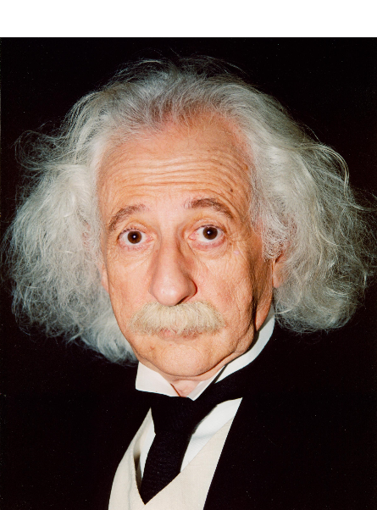
Questions
????

Slide 20
California Association of Long Term Care Medicine
@CALTCM
#CALTCM
@Wassdoc
Check the CALTCM Website (CALTCM.org) and e-newsletter,
the CALTCM Wave, for updates.

