Slide 1
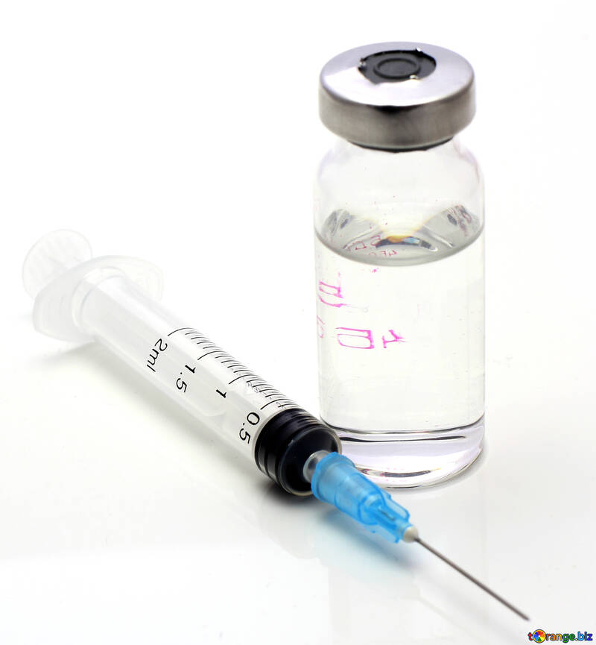
COVID-19 Vaccine: answers to your questions A presentation for Staff and residents in post-acute and Long-Term Care
Michael R. Wasserman, MD, CMD Immediate Past President, CALTCM January 6, 2021
Special thanks to:
Dr. Leslie Eber, AMDA, and the CALTCM Vaccine Delphi Group

Slide 2
What are your concerns?
WE WANT TO HEAR YOUR CONCERNS
YOUR FEELINGS MATTER
YOU HAVE BEEN ON THE FRONT LINES FOR 10 MONTHS
WE RESPECT, HONOR AND VALUE THE WORK THAT YOU DO

Slide 3
Concerns about the COVID-19 Vaccine are real
Specific LTC staff concerns
“Being first”, “Being a Guinea pig”
Vaccine “being rushed”
Safety (side effects)
Not being represented in the vaccine trials
Other important factors
How protective is the vaccine?
How long does protection last?
What is EUA (Emergency Use Authorization)?

Slide 4
Why Should I get vaccinated?
Protect myself and my family
Keep my residents safe
Help stop spread in the community
Set the example for others, including residents, families, co-workers, and the community-at-large

Slide 5
common questions we Will address:
How do we know the vaccine is effective and safe?
Why should we trust the vaccine?
Is there new technology being used and is that dangerous to me?
What is an EUA and what does that mean for me?
When and how long will I be protected?
Will I still need to wear a mask?
What are the expected side effects?
What if I’ve already had COVID-19?
Where should I look to get accurate information?

Slide 6
The First two COVID-19 Vaccines
Both are mRNA vaccines
Pfizer
Moderna
They Do NOT contain COVID-19 virus

Slide 7
COVID-19 Vaccine: mRNA VACCINE, WHAT IS THAT?
New vaccine technology already being used in cancer treatment. It has been studied for more than ten years.
It gives instructions for our cells to make a harmless piece that looks like the “spike protein” found on the surface of the COVID-19 virus.
Our bodies recognize that this protein should not be there, so they build antibodies that will remember how to fight the virus that causes COVID-19 if we are infected in the future.
Can vaccine give me COVID-19? NO
Can vaccine change my DNA? NO
Notes:
Check CDC

Slide 8
Who was included in the COVID-19 Vaccine Trials?
 | Pfizer | Moderna
Number of people enrolled | Over 40,000 | Over 25,000
Race and ethnicity of participants | Total 30% racially diverse 10% black, 13% Hispanic | 37% racially diverse 10% black, 20% Hispanic/Latino
Older adults | 45% were 56-85 years | 23% were >65 years

Slide 9
How Effective are the COVID-19 Vaccines?
 | Pfizer | Moderna
Overall | 95% protection from having the disease | 94.1% protection from having the disease
Similar protection with different race, ethnicity and age

Slide 10
What should I Expect When I Get the vaccine?
THE VACCINE CANNOT GIVE YOU COVID-19!
Most people will have short-term discomfort: Fatigue, headache, muscle pain, chills, fever and pain at injection site after vaccination
These reactions will last for 24-48 hours and are typically more pronounced after the second dose
Side effects mean your body is doing its job and making antibodies (IT IS A GOOD THING)
These side effects are normal, common and expected

Slide 11
What should I Expect When I Get the vaccine?
YOU MUST GET THE SECOND DOSE because the vaccine will not fully protect you if you only get one dose
It is important to get the SAME VACCINE as the first dose

Slide 12
Are the COVID-19 Vaccines Safe?
Safety is the most important priority in vaccine approval
Most side effects occur within 6 weeks of vaccination. To be more cautious, the FDA (Food and Drug Administration) required 8 weeks of safety monitoring of the COVID-19 vaccines
Monitoring for safety will continue as the vaccine is distributed to the public
To assess safety FDA typically advises that a minimum of 3,000 participants are included in the trial. The current COVID-19 vaccine trials include 30,000 to 50,000 participants

Slide 13
Why should we trust the COVID-19 Vaccine?
The FDA is using the same strict standards that it has for decades
No steps are “skipped”
Two independent advisory committees reviewed the results. Members and experts of these committees have no conflict of interest and are not associated with any vaccine manufacturers
The Vaccine and Related Biological Products Advisory Committee (VRBPAC) that advises the FDA
The Advisory Committee on Immunization Practices (ACIP) that advises the CDC

Slide 14
What is an EUA and what does that mean for me?
An Emergency Use Authorization (EUA) for a vaccine is based on the need to use a vaccine quickly to save lives during a public health emergency
EUA is a shorter process but no steps are skipped in the safety evaluation process
The FDA assessed if the vaccine known and potential benefits outweigh the risks
Two separate advisory boards (VRBPAC and ACIP) will also review the data and make recommendations
An EUA does NOT imply that the authorization was done too quickly or that the vaccine is not safe

Slide 15
How was the vaccine developed so quickly?
Major reasons we were able to get these vaccines developed more quickly than usual include :
Global effort with the world’s leading scientists focused on a single task
Nearly unlimited resources (money, knowledge, manpower, technology)
A large pool of diverse adult volunteer trial participants

Slide 16
When and how long will I be protected by the COVID-19 Vaccine?
Most of the vaccines are 2 doses, 3-4 weeks apart.
Full protection occurs 1-2 weeks after the second dose.
We will most likely not know how long the vaccine will be protective once we receive it. We will know more as more time passes in the current research.
May need to have vaccine shots for COVID-19 on a regular basis (like the flu shot).

Slide 17
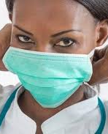
Will I Still need to wear a Mask?
YES !
Similar to other vaccines, a large number of people in the community will need to get vaccinated before transmission drops enough to stop the use of masks
Also, nothing is 100%
And…WEAR MASKS PROPERLY!!
And…keep washing your hands!!!

Slide 18
Special circumstance What if I already had covid-19?
It is safe to get the COVID-19 vaccine even if you have had COVID-19?
Even if you have had COVID-19, it is important to get vaccinated. It could give you longer or better protection against the disease.
Even if you have positive antibodies, you should get the COVID-19 vaccine.

Slide 19
Where should I look to get accurate information?
It is important to get information from reliable sources (CDC, AMDA, medical directors, providers) Social media is full of misinformation and opinions based on that misinformation.
Here are some link to information:
CDC: https://www.cdc.gov/vaccines/hcp/covid-conversations/answering-questions.html
CDC: About COVID-19 vaccines: https://www.cdc.gov/coronavirus/2019-ncov/vaccines/about-vaccines.html
CDC: Provider Resources for COVID-19 Vaccine Conversations with Patients and Answering Patients’ Questions: https://www.cdc.gov/vaccines/hcp/covid-conversations/

Slide 20
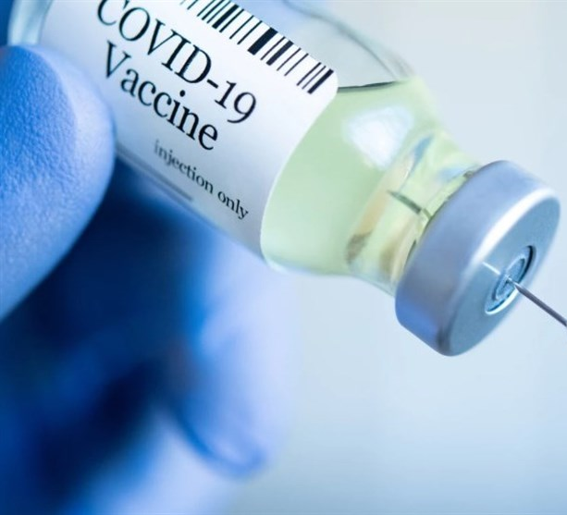
Vaccines Are the only way to control the COVID-19 Pandemic
If everyone gets vaccinated, we can get back to a normal life

Slide 21
Why Should I get vaccinated?
Protect myself and my family
Keep my residents safe
Help stop spread in the community
Set the example for others, including residents, families, co-workers, and the community-at-large

Slide 22
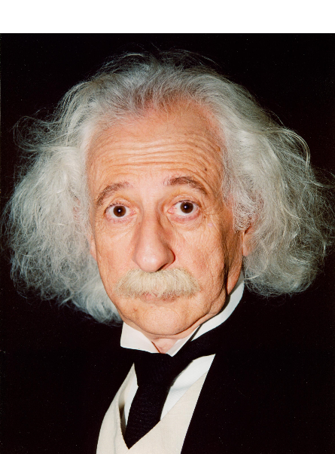
Questions
???

Slide 23
California Association of Long Term Care Medicine
@CALTCM
#CALTCM
@Wassdoc
Check the CALTCM Website (CALTCM.org)
and e-newsletter, the CALTCM Wave, for updates.

